Slide 1
Lab# 10 Thread Synchronization and Mutexes
CS311L
Lab Engr. Asima Sarwar

Slide 2
Learning Objectives
After the completion of this lab, the students will be able:
To understand thread synchronization
To use mutexes in thread synchronization

Slide 3
Thread Synchronization and Mutexes
Thread synchronization is the concurrent execution of two or more threads that share critical resources
Threads should be synchronized to avoid critical resource use conflicts
Otherwise, conflicts may arise when parallel-running threads attempt to modify a common variable simultaneously
A mutual exclusion (mutex) is a program object that prevents simultaneous access to a shared resource
This concept is used in concurrent programming with a critical section, a piece of code in which processes or threads access a shared resource
Only one thread owns the mutex at a time. Thus, a mutex with a unique name is created when a program starts
When a thread holds a resource, it has to lock the mutex from other threads to prevent concurrent access to the resource
Upon releasing the resource, the thread unlocks the mutex

Slide 4
Thread Synchronization
Thread synchronization is defined as a mechanism that ensures that two or more concurrent processes or threads do not simultaneously execute some particular program segment, known as a critical section
Processes’ access to critical sections is controlled by using synchronization techniques
When one thread starts executing the critical sections (a serialized segment of the program) the other thread should wait until the first thread finishes
If proper synchronization techniques are not applied, it may cause a race condition where the values of variables may be unpredictable and vary depending on the timings of context switches of the processes or threads

Slide 5
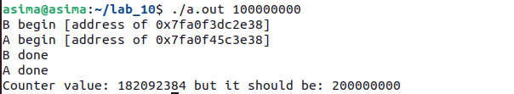
#include <stdio.h>
#include <stdlib.h>
#include <pthread.h>
int max;
int counter = 0;
void *mythread(void *arg) {
char *letter = arg;
int i;
printf("%s: begin [addr of %p]\n", letter, &i);
for (i = 0; i < max; i++) {
counter = counter + 1;}
printf("%s: done\n", letter);
return NULL;
}
int main(int argc, char *argv[]) {
max = atoi(argv[1]);
pthread_t p1, p2;
pthread_create(&p1, NULL, mythread, "A");
pthread_create(&p2, NULL, mythread, "B");
pthread_join(p1, NULL);
pthread_join(p2, NULL);
printf(“Counter value: &d but it should be &d”, counter, 2*max);
return 0;
}
Output:

Slide 6
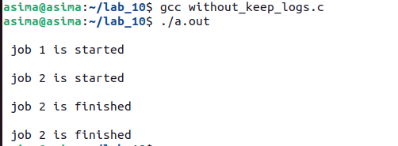
#include <pthread.h>
#include <stdio.h>
#include <stdlib.h>
#include <string.h>
#include <unistd.h>
pthread_t tid[2];
int counter;
void* trythis(void* arg)
{
unsigned long i = 0;
counter += 1;
printf("\n Job %d is started\n", counter);
for (i = 0; i < (0xFFFFFFFF); i++)
;
printf("\n Job %d is finished\n", counter);
return NULL;
}
int main(void)
{
int i = 0;
int error;
while (i < 2) {
error = pthread_create(&(tid[i]), NULL, &trythis, NULL);
if (error != 0)
printf("\nThread can't be created : [%s]", strerror(error));
i++;
}
pthread_join(tid[0], NULL);
pthread_join(tid[1], NULL);
return 0;
}
Output:

Slide 7
Code Explanation and Problem
The log ‘Job 2 has started’ is printed just after ‘Job 1 has Started’, so it can easily be concluded that while thread 1 was processing, the scheduler scheduled thread 2
If we take the above assumption as true, then the value of the ‘counter’ variable got incremented again before job 1 got finished
So, when Job 1 actually got finished, then the wrong value of counter produced the log ‘Job 2 has finished’ followed by the ‘Job 2 has finished for the actual job 2 or vice versa as it is dependent on the scheduler
So we see that it is not the repetitive log but the wrong value of the ‘counter’ variable that is the problem
The actual problem was using the variable ‘counter’ by a second thread when the first thread was using or about to use it
In other words, we can say that lack of synchronization between the threads while using the shared resource ‘counter’ caused the problems, or in a word, we can say that this problem happened due to a ‘Synchronization problem’ between two threads

Slide 8
Race Condition & Critical Section
A race condition (or data race) arises if multiple threads of execution enter the critical section roughly simultaneously; both attempt to update the shared data structure, leading to a surprising (and perhaps undesirable) outcome
A critical section is a piece of code that accesses a shared variable (or, more generally, a shared resource) and must not be concurrently executed by more than one thread

Slide 9
Mutex
A Mutex is a lock that we set before using a shared resource and release after using it
When the lock is set, no other thread can access the locked region of the code
So we see that even if thread 2 is scheduled while thread 1 was not done accessing the shared resource and the code is locked by thread 1 using mutexes, then thread 2 cannot even access that region of code
So this ensures synchronized access to shared resources in the code

Slide 10
Mutex Working
Suppose one thread has locked a region of code using mutex and is executing that piece of code
Now, if the scheduler decides to do a context switch, all the other threads that are ready to execute the same region are unblocked
Only one of all the threads would make it to the execution, but if this thread tries to execute the same region of code that is already locked, then it will again go to sleep
Context switch will take place again and again, but no thread would be able to execute the locked region of code until the mutex lock over it is released
Mutex lock will only be released by the thread that locked it
So this ensures that once a thread has locked a piece of code, then no other thread can execute the same region until it is unlocked by the thread that locked it

Slide 11
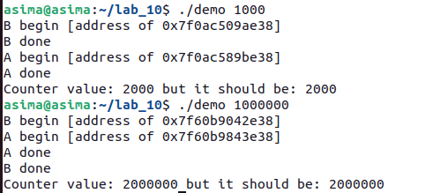
#include <stdio.h>
#include <stdlib.h>
#include <pthread.h>
int max; pthread_mutex_t lock; int counter = 0;
void *mythread(void *arg) {
char *letter = arg; int i;
printf("%s: begin [addr of i: %p]\n", letter, &i);
for (i = 0; i < max; i++) {
pthread_mutex_lock(&lock);
counter = counter + 1;
pthread_mutex_unlock(&lock) }
printf("%s: done\n", letter);
return NULL;}
int main(int argc, char *argv[]) {
max = atoi(argv[1]);
pthread_t p1, p2;
pthread_mutex_init(&lock, NULL);
pthread_create(&p1, NULL, mythread, "A");
pthread_create(&p2, NULL, mythread, "B");
pthread_join(p1, NULL);
pthread_join(p2, NULL);
printf(“Counter value: %d but it should be %d”, counter,2*max);
return 0;}
Output:

Slide 12
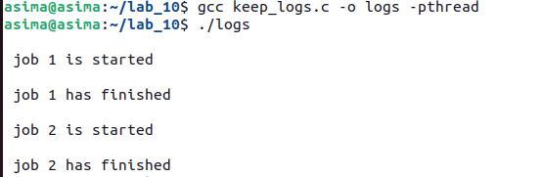
#include <pthread.h>
#include <stdio.h>
#include <stdlib.h>
#include <string.h>
#include <unistd.h>
pthread_t tid[2]; int counter; pthread_mutex_t lock;
void* trythis(void* arg)
{
pthread_mutex_lock(&lock);
unsigned long i = 0;
counter += 1;
printf("\n Job %d is started\n", counter);
for (i = 0; i < (0xFFFFFFFF); i++);
printf("\n Job %d has finished\n", counter);
pthread_mutex_unlock(&lock);
return NULL;
}
int main(void)
{
int i = 0;
int error;
while (i < 2) {
error = pthread_create(&(tid[i]), NULL,&trythis, NULL);
if (error != 0)
printf("\nThread can't be created :[%s]",strerror(error));
i++;}
pthread_join(tid[0], NULL);
pthread_join(tid[1], NULL);
pthread_mutex_destroy(&lock);
return 0;}

Slide 13
Task #1
Write a C code that create 10 threads and all of them try to call a function name counter. In counter function create a static local variable named count initialized with 10. Update that count variable 1 by each thread to displays counting from 10 to 20. Write the code both without and with mutex lock

Slide 14
Tasks # 2
Write a program that declares a global linked list structure. It should initialize this linked list.
Then it should create 4 threads in parallel.
Each thread should insert 10000 elements in that linked list.
The main thread waits for the 4 threads to finish.
It then prints the total number of elements in the global linked list. The total number of elements should be equal to the sum of elements inserted by each thread.
Follow this roadmap:
Create a program that creates a global linked list.
Create a function to insert an element in the linked list.
Create a function to print the number of elements in the linked list.
In the main () function, insert 10000 elements and then print their number.
Now try doing the task using 4 threads each inserting 10000 elements:
First without synchronization
With synchronization

